Slide 1
Adaboost-Based Eye Detection
Group: Luting Wang, Jiashen Zhang
Date: 2015/12/03

Slide 2
Basic Tools:
OpenCV 3.0
Visual Studio 2013
1

Slide 3
Haar feature-based Cascade classifiers
Extract Haar-like features ( positive/negative images)
Use Integral Image ( speed up calculation)
Train strong classifier used Adaboost algorithm
Cascade strong classifiers together
Sliding window to detect
2
Notes:
The main part of our project is how to train a haar feature-based cascade classifiers. There are several steps. First is to extract harr-like features in positive and negative images. Then as Professors mentioned in class, we use integral image to speed up calculation. The major step is to train strong classifier used Adaboost algorithm, which will be illustrated later. In an image, most of the image region is non-face region. So it is a better idea to have a simple method to check if a window is not a face region. If it is not, discard it in a single shot. Don’t process it again. Instead focus on region where there can be a face. This way, we can find more time to check a possible face region. So we cascade many strong classifiers together to obtain a final classifier. Last, we use slidnng window to perform detection

Slide 4
Adaboost algorithm
A machine learning meta-algorithm formulated by Yoav Freund and Robert Schapire ;
Boost weak classifiers together into a strong classifier;
For each iteration, pick the optimal weak classifier with the lowest error rate, and update sample’s weight (weights of misclassified samples will be increased, so later weak classifiers will focus on training these misclassified samples);
Final classifier is a weighted sum of these weak classifiers .
3
Notes:
Now I will explain how Adaboost algorithm works.

Slide 5
Implementation
cascade.load("haarcascade_frontalface_alt.xml");
nestedCascade.load("haarcascade_eye_tree_eyeglasses.xml");
cvtColor; //covert to gray image
resize; //change image size
equalizeHist; // Histogram Equalization
cascade.detectMultiScale //detect face of different scales
nestedCascade.detectMultiScale //detect eyes in ROI region
4
Notes:
This is our code implementation. OpenCV already contains many pre-trained classifiers for face, eyes, smile etc. For each frame, we first change it to gray color, resize it to speed up, and perform histogram equalization. Then we perform face detection in different scale. After we detect face region, we set the region as ROI and detect eye in this region.

Slide 6
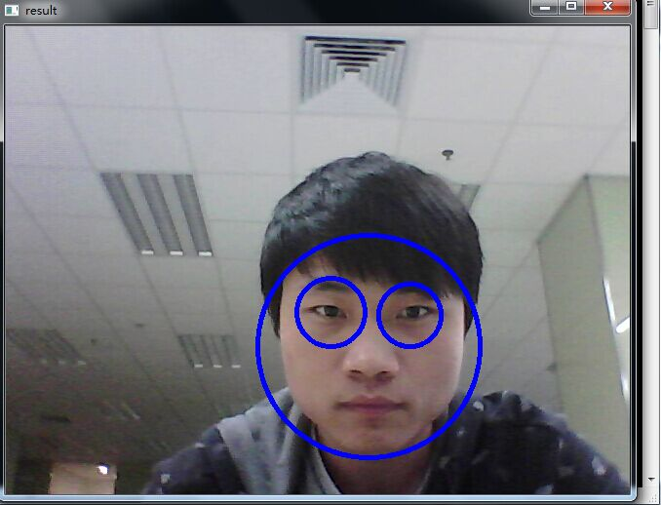
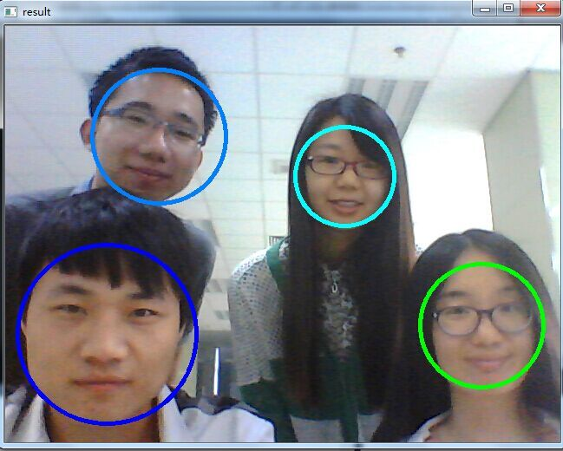
Our Results
5
Welcome Jiashen to demo!
Notes:
This is our result, and my partner Jiashen will give you a demo.

Slide 7
Thank you!
References:
[1] Viola P, Jones M. Rapid object detection using a boosted cascade of simple features
[2] Viola P, Jones M J. Robust real-time face detection
[3] Face Detection using Haar Cascades, OpenCV-Python Tutorials,

